Slide 1

Zomato Order & Restaurant Analysis Using Power BI
Food & Beverage, Business Analytics

Slide 2
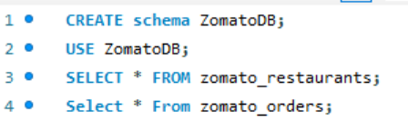
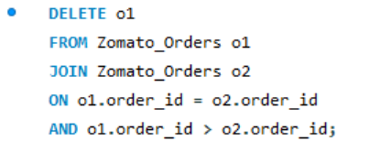
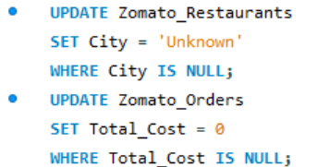
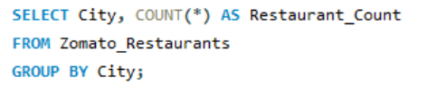
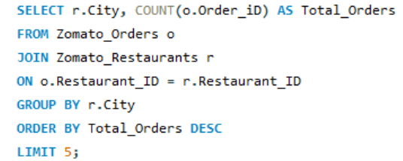
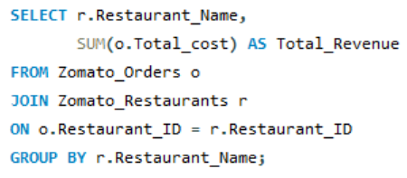
MY SQL Tasks
Task 1 – Upload Dataset into MySQL
Step 1: Created Schema: ZomatoDB
Step 2: Import tables in Schema
Task 2 – Data Transformation using SQL
1.Basic Data Cleaning
A.Remove Duplicate Records
B. Handle NULL Values
2.Data Exploration Queries
A. Count number of restaurants in each city
B. Top 5 cities with highest number of orders
C. Total revenue generated by each restaurant

Slide 3
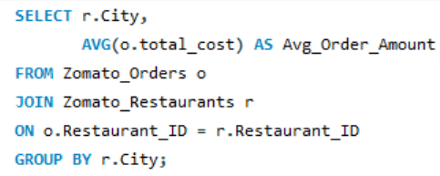
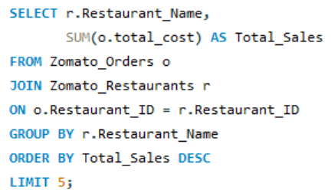
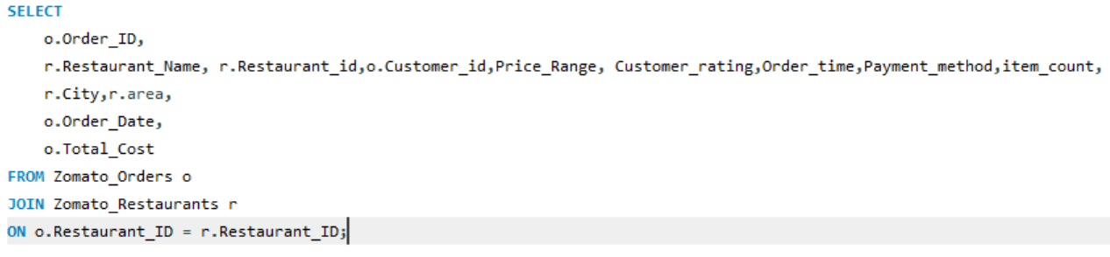
MY SQL
3.Data Aggregation
A. Average order amount for each city
B. Top 5 restaurants with highest total sales
4.Data Joins
5.Export the transformed dataset
Joined Zomato_Orders and Zomato_Restaurants using Restaurant_ID
Exported transformed data to Excel for Power BI usage

Slide 4
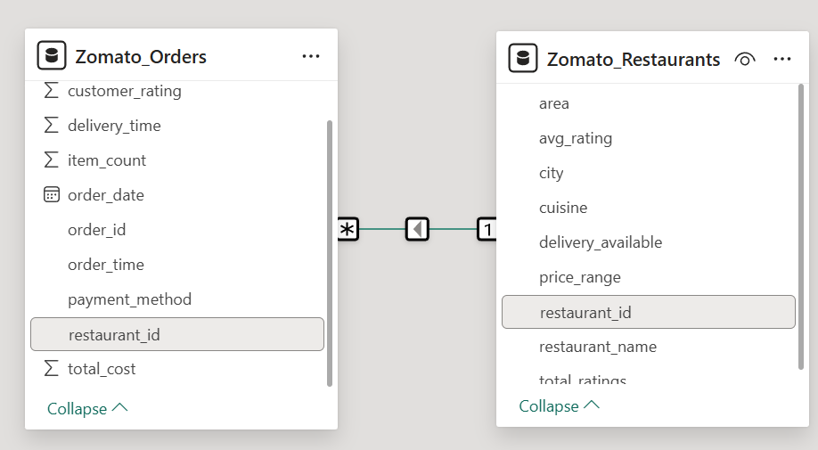
MY SQL
Task 3 – Power BI Data Preparation
Step 1: Imported Excel file into Power BI
Step 2: Performed data cleaning in Power Query Editor
Step 3: Set correct data types
Step 4:Removed unnecessary columns
Step 5:Data Modeling
Relationship between Restaurant_ID in both datasets.

Slide 5
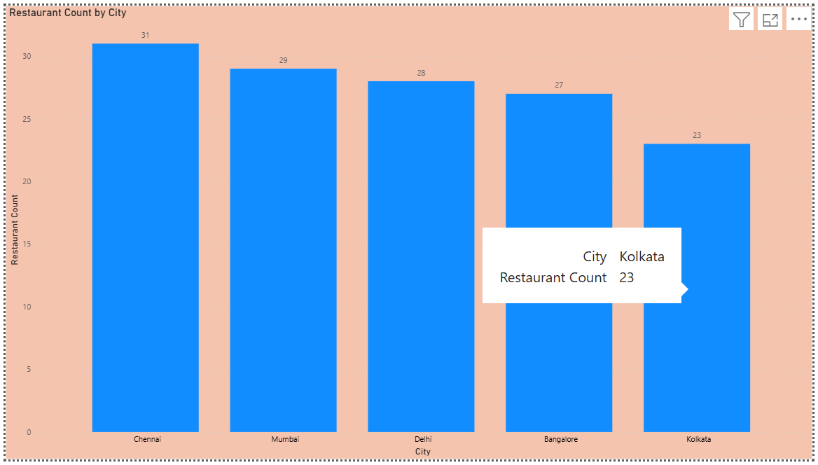
Power BI tasks
Task 1 – Number of Restaurants per City
Bar chart
Chennai has the highest number of restaurants (31), indicating strong food demand,
while Kolkata has the lowest (23), suggesting potential market expansion opportunities.
Insights:
Helps identify high-demand cities for new restaurant onboarding
Supports market entry and expansion decisions
Recommendation : Increase promotional campaigns in low-density cities like Kolkata to attract new restaurant partners.
Identified cities with high and low restaurant density
Analyzed correlation with demand and population

Slide 6
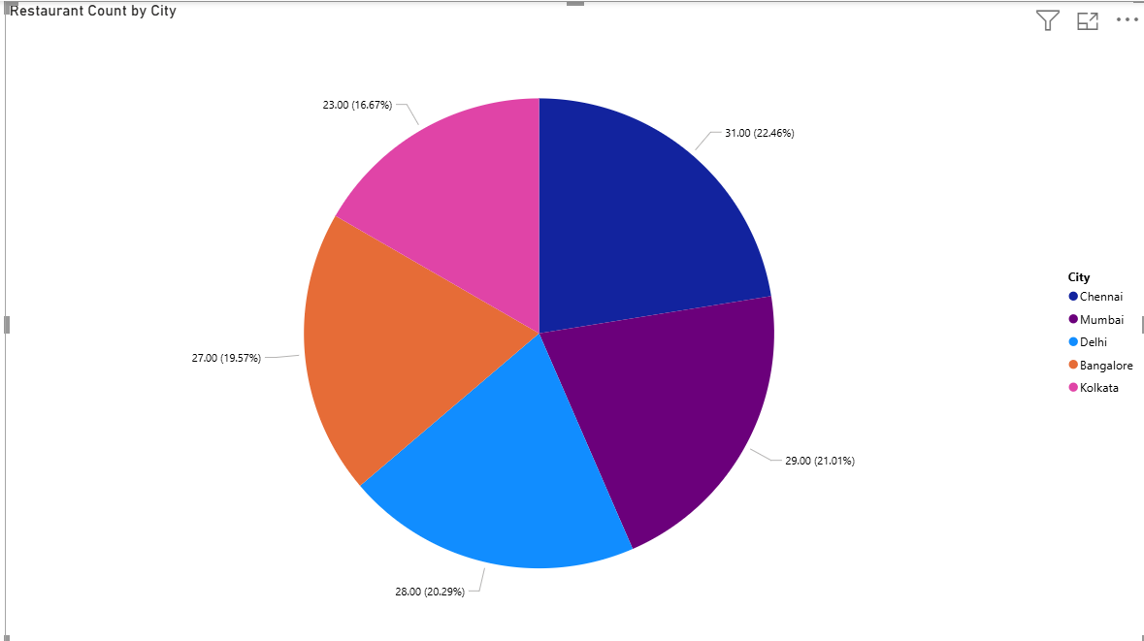
Power BI tasks
Task 2 – Number of Restaurants per City
Pie chart showing % of Number of Restaurants
Chennai has the highest restaurant presence, indicating strong market penetration and demand. Kolkata has the lowest number of restaurants, suggesting potential opportunities for expansion
Insights:
High restaurant concentration in Chennai and Mumbai reflects strong demand, while Kolkata presents expansion opportunities
Recommendation: Focus on onboarding new restaurants in Kolkata and strengthen competitive positioning in high-density cities.
Identified cities dominating order volume
Compared restaurant density vs demand

Slide 7
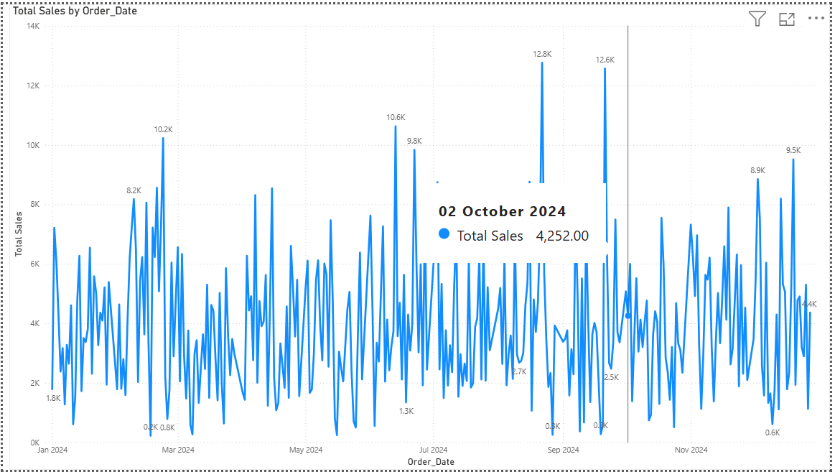
Power BI tasks
Task 3 – Order Trends Over Time
Line chart (Date vs Total Sales)
Order volume shows high day-to-day variability with noticeable spikes during specific periods, indicating peak demand days and possible promotional or seasonal effects.
Insights:
Enables demand forecasting
Supports staffing and delivery partner planning
Helps optimize inventory and restaurant readiness
Recommendation: Increase delivery workforce and run targeted promotions during identified peak periods to maximize order fulfillment and revenue.
Highest sales observed during early October and mid-November
Lower order volumes during off-peak weekdays

Slide 8
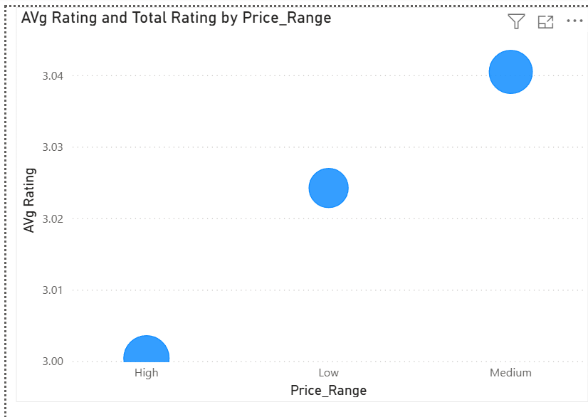
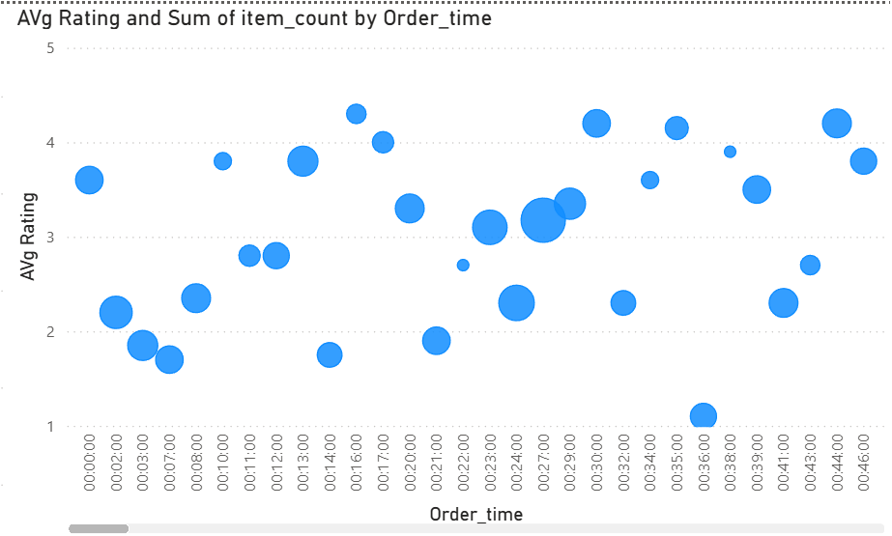
Power BI tasks
Task 4 – Rating Correlation Analysis
Scatter plots / correlation visuals
Factors Analyzed:
Price
Delivery time
Total ratings
Order count
Shorter delivery times and higher service quality improve ratings
Medium-priced restaurants have the highest average ratings, indicating a strong balance between affordability and customer satisfaction.
Insights:
Customers tend to rate mid-range restaurants more favorably
High-priced restaurants receive slightly lower average ratings, possibly due to higher expectations
Low-priced restaurants show good engagement but moderate ratings

Slide 9
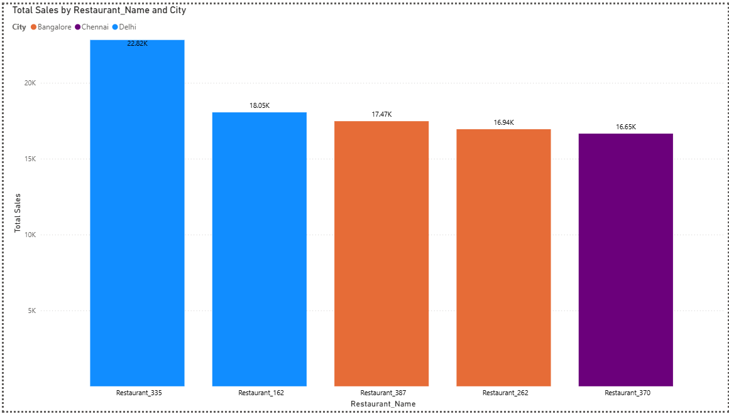
Power BI tasks
Task 5 – Top 5 Restaurants by Sales
Stacked Column Chart
Restaurant_335 in Delhi generates the highest total sales, indicating strong customer demand and operational efficiency compared to other top restaurants.
Insights:
Helps identify best-performing restaurant partners
Supports partnership expansion and incentives
Guides best-practice replication across cities
Recommendation: Analyze operational strategies of top-performing restaurants and replicate them across lower-performing outlets to boost overall sales.
Top restaurants outperform due to higher order volume and pricing strategy

Slide 10
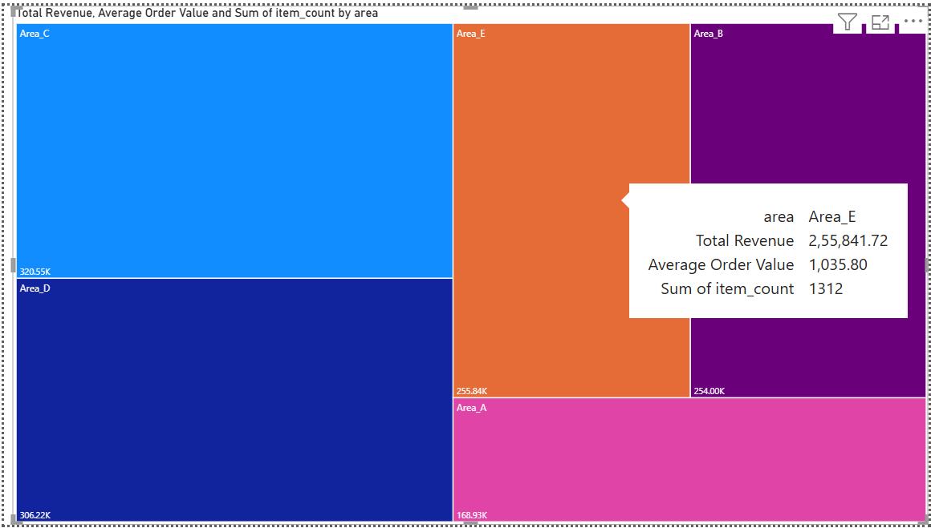
Power BI tasks
Task 6 – Revenue by Area
Tree Map
Note:Area C and Area D generate the highest total revenue, while Area E shows a strong balance of high average order value and item volume.
Insights:
Helps identify high-value delivery zones
Supports area-specific pricing and promotion strategies
Assists in delivery capacity and logistics planning
Recommendation: Increase premium restaurant partnerships and faster delivery options in high-AOV areas like Area E, while boosting promotional offers in lower-revenue areas to drive order volume.
Identified high-performing and low-performing areas
Revenue driven by order volume and order value

Slide 11
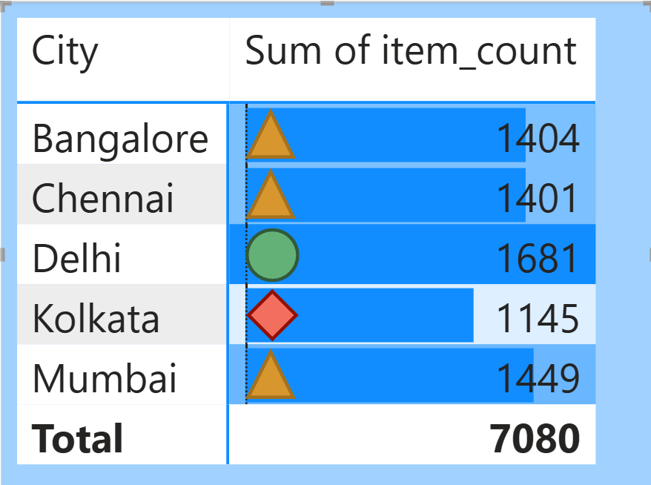
Power BI tasks
Task 7 – Order Density Heat Map
Heat map
Note:Delhi has the highest item demand, while Kolkata shows comparatively lower order volume, indicating uneven demand distribution across cities.
Insights:
Helps plan inventory and restaurant capacity
Supports city-level demand forecasting
Enables targeted city-wise promotions
Recommendation: Increase delivery partner availability and stock readiness in high-demand cities like Delhi, while running promotional campaigns in lower-demand cities such as Kolkata.
🟢 High demand (Above average)
🟡 Medium demand (Near average)
🔴 Low demand (Below average)

Slide 12
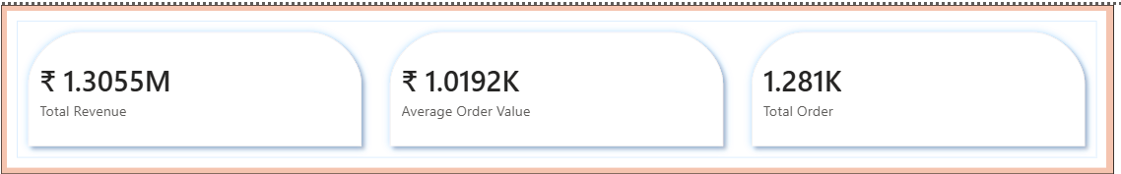
Power BI tasks
Task 8 – KPI Cards
Total Revenue: Sum of completed order values
Average Order Value (AOV): Revenue ÷ Total Orders
Total Orders: Count of completed orders
Target Revenue: ₹1.25M → Achieved 104%
AOV Target: ₹1,000 → Above Target
Note: Strong revenue performance is driven by healthy order volume and stable average order value.

Slide 13
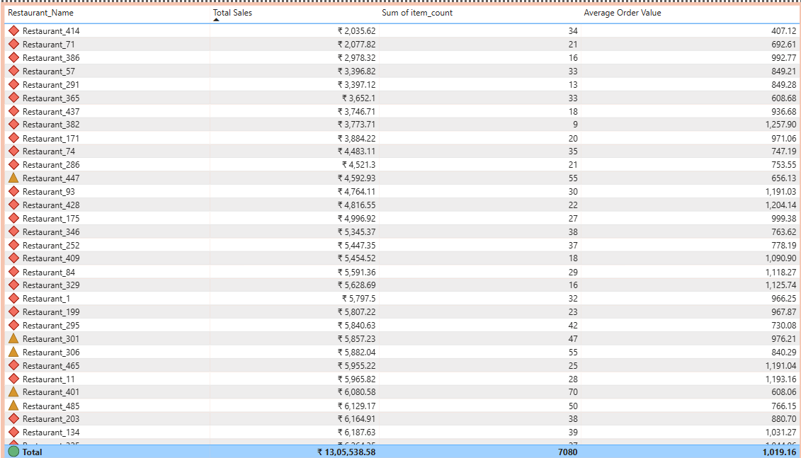
Power BI tasks
Task 9 – Restaurant-Wise Sales Table
🥇 Restaurant_325 and Restaurant_134 have the highest average order value (₹1,031.27) despite low item counts.
📦 Restaurant_306 and Restaurant_447 have high item volumes (55 each), indicating strong throughput.
💰 Restaurant_329 and Restaurant_84 show high total sales with premium order values, suggesting loyal or high-spending customers.
Recommendation: Restaurants with high average order value but low item count may benefit from bundling strategies. High-volume performers could be optimized for delivery efficiency or upselling.
Table Metrics:
Restaurant Name
Total Sales
Number of Orders
Average Order Value
Features:
Sorting
Conditional formatting
Filters by city, area, and price range

Slide 14
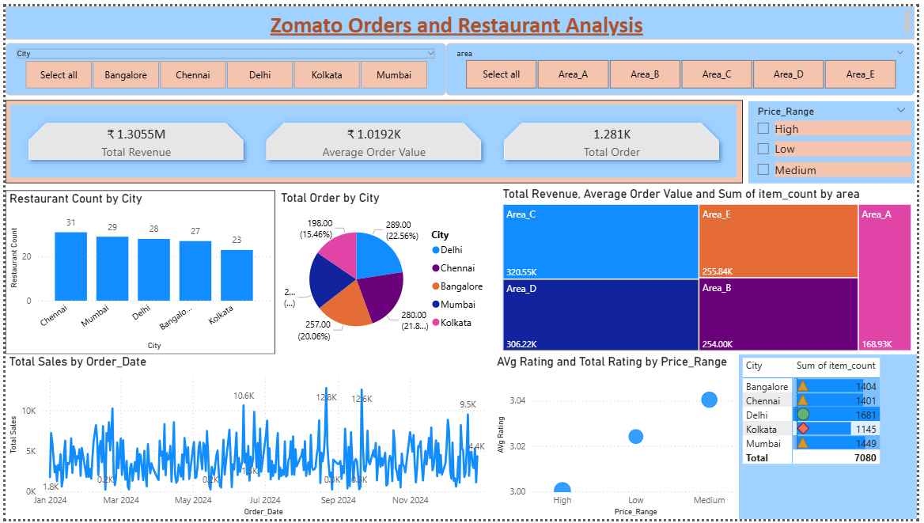
Power BI tasks
Task 10 – Final Dashboard
Chennai and Mumbai dominate in both restaurant presence and order volume.
Area_C’s revenue leadership suggests a high-performing cluster worth deeper investment.
September’s sales spike may reflect seasonal trends or successful promotions, warranting replication
Insights:
Expand high-performing areas like Area_C with more delivery partners.
Investigate September’s sales drivers for repeatable campaigns.
Consider bundling strategies in low item-count, high AOV restaurants.
All visuals integrated into a single interactive dashboard
Filters & slicers for city, area, restaurant
Clean layout for effective storytelling

